Slide 1

Solutions for Pollution

Slide 2
Declination of Oxygen -increase in pollution
A new study shows Earth's oxygen levels continue to decline, a phenomena that has puzzled scientists. The study , published in science by Princeton University.
The study finds that over the past 800K years the amount of oxygen found in the atmosphere has decreased by 0.7% and continues to decline..
Fortunately, this decline is not something that will or has caused significant problems for life on Earth. An equivalent decrease in oxygen content would accompany a change in elevation from sea level to 100 meters above sea level

Slide 3
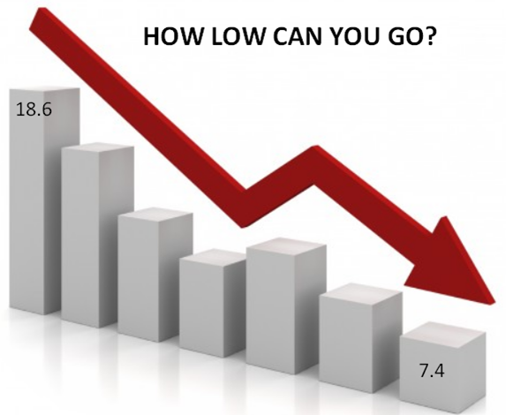
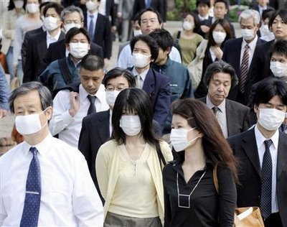

Slide 4

Is there any solution??

Slide 5
General Solutions :
Plant trees in surroundings and make them grow.
Use of hydrogen as a fuel in automobiles rather than petrol .
Use of solar power and reducing the use of resources like coal(thermal power).
Avoid storing excess food and cook it based on requirements, as this may reduce the use of refrigerators.
Usage of CNG in the vehicles.
Control using of plastic materials that are non degradable in the earths crust.

Slide 6
OUR SOLUTIONS: 1.UNDERGROUND AFFORESTATION
It can be initiated by making plantations under the earth surface.
This is the best method to be adopted for high demand of Oxygen
No effect is done to the mankind
Can be done by the tunnel technologies

Slide 7
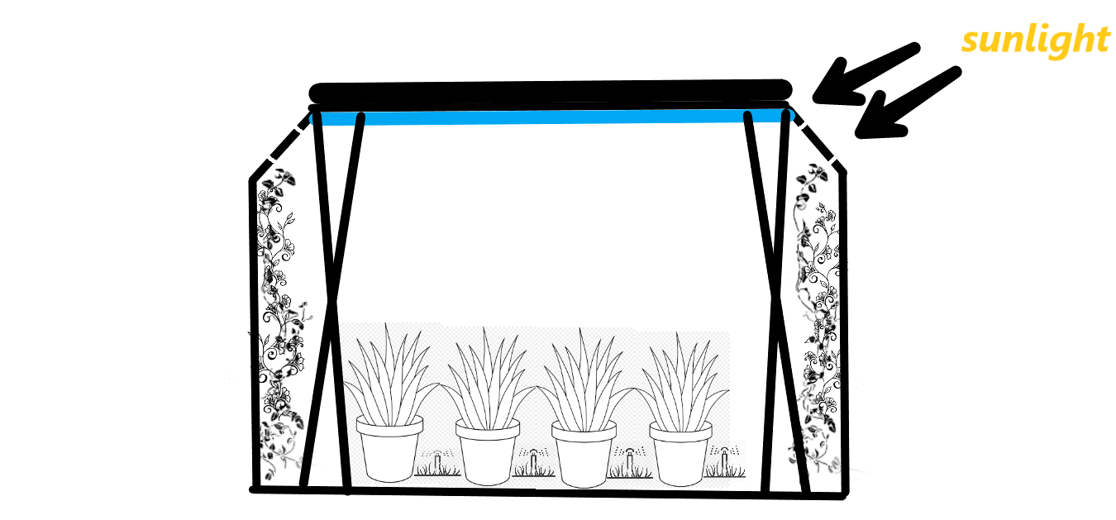
Prototype :

Slide 8
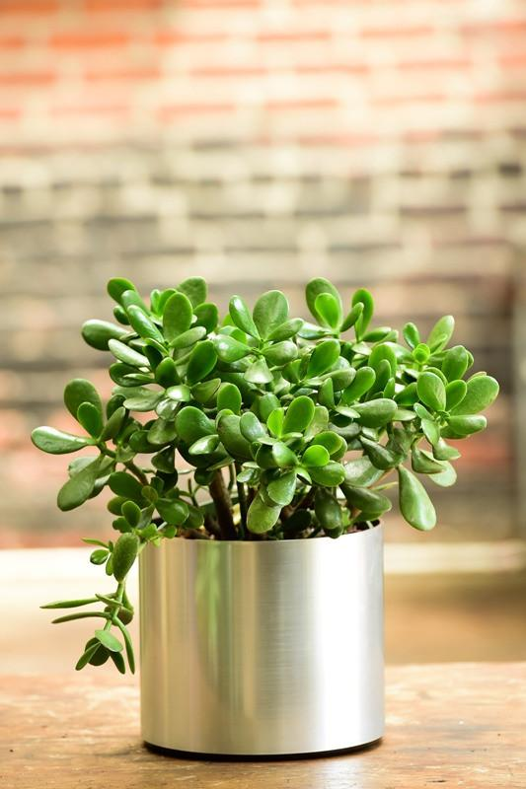
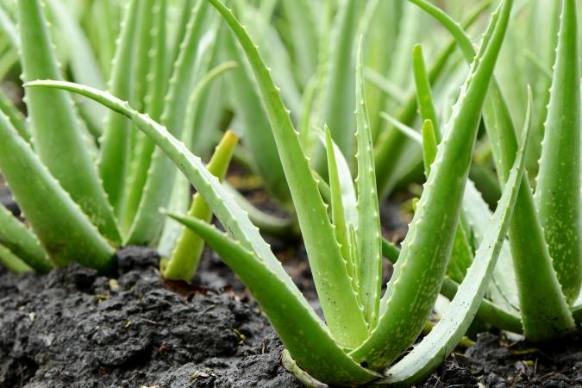
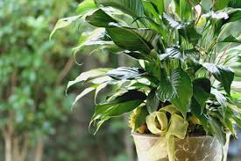
Suitable plants : *Aloe Vera *Gerbera Daisy *Peacy lily *Jade plant etc …

Slide 9
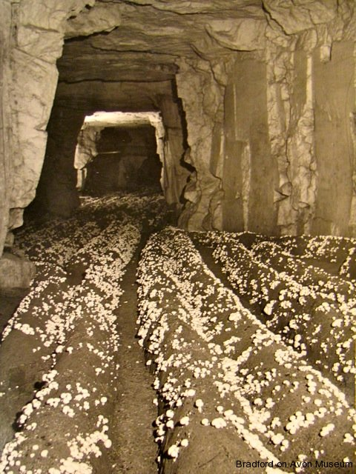
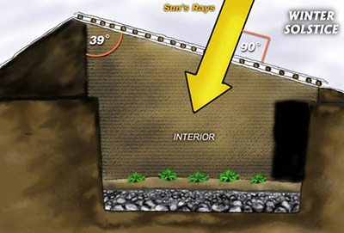
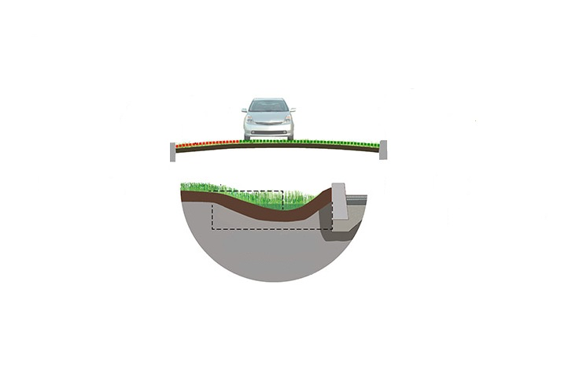

Slide 10
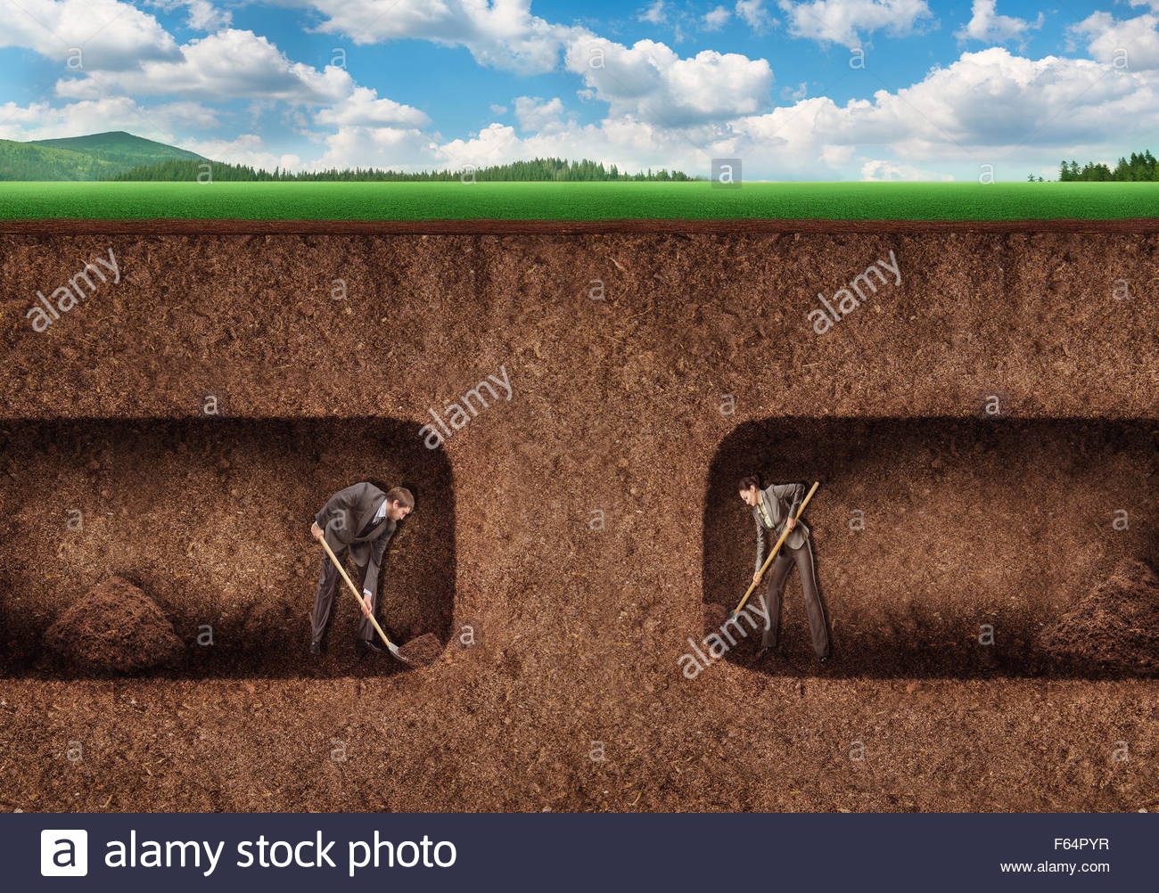
Benefits
Reduces land consumption.
Ease of availability of fresh oxygen.
Highly beneficial for upcoming generations.
No effect for mankind.

Slide 11
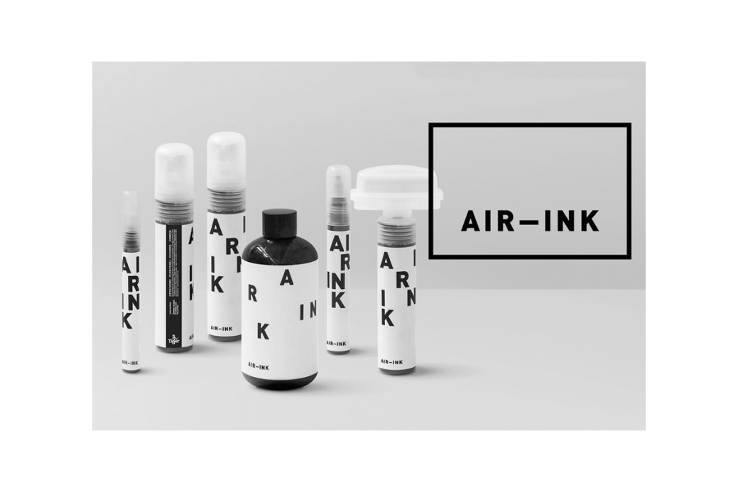
2.AIR INK
The first ink made out of recycled air pollution.
Its overall purpose is to reduce the amount of particulate matter in the air.
It mainly uses a device called KAALINK which captures carbon emissions from vehicles or chimneys before it enters into atmosphere.

Slide 12
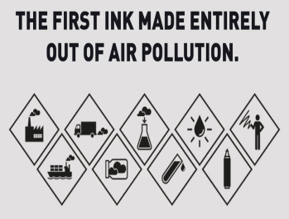
PROCESS OF MAKING:

Slide 13

HISTORY
Anirudh Sharma, founder of Gravity Labs, first conceived the idea of Air Ink in 2013.
In 2016, Air Ink products were commercially available to graphic artists.
Prepared anciently but being used in a great extent

Slide 14
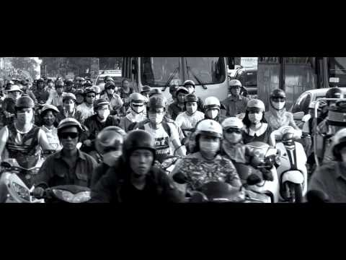

Slide 15
HOW DOES IT MADE?
Kaalink, a device that, once placed on exhaust pipes, captures pollutants.
Its a mechatronic system which consists of electrostatic filtration, depth filtration, wall flow filtration etc..to filter soot.
The final product called carbon is then mixed with different types of oils and solutions to form inks and paints.

Slide 16
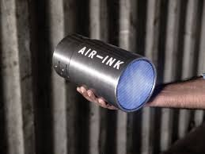
FEATURES :
Every 45 min worth of car emissions- 30 ml of ink.
600 ml spray- holds the equivalent of 2000 hrs of pollution.
Kaalink can even fit over the polluting mouths of boats, chimneys and cranes.
It not only stops co2 gas enter into air but also captures a dangerous carbon soot called PM 2.5
Each device can collect up to 95% of pollutants.

Slide 17
Conclusion : These methods are highly preferable as they undergo many advantages as shown . These are the some of the new innovations to be made for a comfort zone in this modern era we are living.

Slide 18

Presented by : 180050068 Y.Bharadwaj

